Slide 1
CA PPM for Strategic Planning and Execution
Please print only when necessary to avoid needless waste of paper and toner.
Strategic Execution Support Alexandre Assis, PMP®
January 2016

Slide 2
CA PPM for Strategic Planning and Execution
Overview of Strategic Planning and Execution Support with CA PPM
A Strategic Plan only makes sense when it is directly connected to a decision-making process regarding the necessary resources and investments that will make it possible for actual Results to be delivered through an effective and efficient Execution.
The “CA PPM for Strategic Planning and Execution” accelerator was created to help our customers implement this constant feedback cycle between Planning and Execution.
Notes:
This is the RATIONALE for this Accelerator.
There is nothing new about Strategic Planning, right? All organizations, big or small, have implemented some sort of strategic planning method these days, obviously with different maturity levels, granularity, precision; some are at department level, some at business unit level, some at corporate level, or even all of the above...
Many of our PPM customers need a way to “do the right things”- that is – selecting the best investments on which apply your financial and human resources in order to achieve optimal results. However, one of the most challenging aspect our customers are finding is: how can I connect both worlds Strategic Planning and Project Execution?
Are the things I’m doing THE best to achieve the results I proposed to achieve with my Strategic Plan?
Is the way our projects are being delivered generating any impact – positive or negative – on the results?
Do I need to correct anything on our Execution?
How much of my Goals have I already reached – and what is the forecast – When will I be able to see the final results of the Strategies?

Slide 3
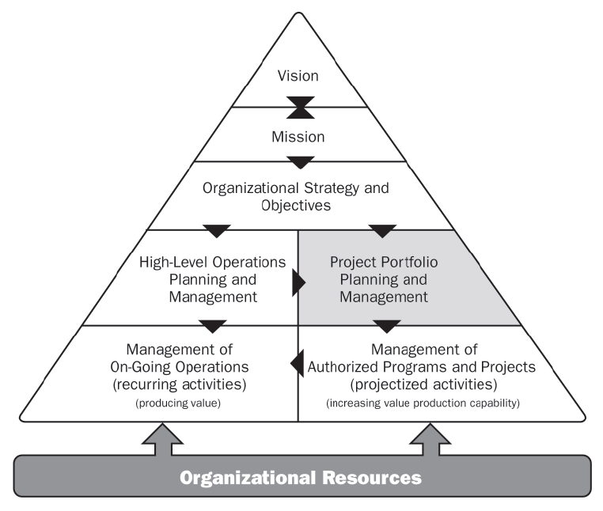
Expanding CA PPM capabilities
CA PPM PMO Accelerator Out-of-the-box capabilities
CA PPM configuration for Strategic Planning and Execution additional capabilities
Source: Project Management Institute, The Standard for Portfolio Management, second edition.
Notes:
CA PPM for Strategic Planning and Execution expands CA PPM Core Features towards Strategic Planning and Monitoring Business Results in relation to the Organization’s Strategies.

Slide 4
CA PPM for Strategic Planning and Execution
Implementing a Continuous Strategic Planning process
The Strategic Plan drives the Investment Budget and defines metrics for later use in the selection of Investments to be executed.
The Investment Budget originates the Portfolios, applying the selection and prioritization criteria to define programs and projects to be executed – given the execution capacity (financial and human resources).
Execution is monitored because the progress of programs and projects indicates the trend of success in the achievement of goals; this allows the rapid correction of direction when necessary.
Indicators feed the strategic plan with measurements to be compared to the established targets for verification of actual results.
Strategic Plan
Bottom-Up Indicators
Top-Down Portfolios
Execution
Initiatives Portfolio
Program and Project Selection
Actual
Results
Overall Investment
Health-Check
Selection Metrics
Measurements
Continuous Strategic Planning
Execution Capacity (CAPEX and Headcount)
Resource Usage
Constraints and Criteria-based Selection with Objective Metrics
Notes:
Our suggestion is to implement a “Continuous Strategic Planning and Execution” process. The Strategic Plan brings multiple levels of strategic goals to our organization. It also defines the metrics that allow us to score our investments against those goals. From the Strategic Plan we start distributing funds and headcount through a Top-Down Planning process. The Top-Down budget will fund and source Strategic Initiative Portfolios. In the Portfolios we will be able to balance our strategic-driven Portfolio Targets (Headcount and CAPEX) and our Strategic demand – by using our investment strategic alignment score and other investment criteria such as risk and ROI fro Prioritizing and Selecting the best Investments to deliver on our strategy, resulting in a Portfolio of Prioritized Programs and Projects that were selected to maximize our strategic results. That is what we call Strategic Execution – the ability to link the Top-Down Strategic Planning Decision-Making process directly to the Tactical level Portfolio Decisions and Operational level Initiatives, Investments and Project Execution. At the same time, the detailed execution of these programs and projects needs to be constantly monitored – because they will serve as a strategy “health-check”. We say that because the programs and projects are the means to delivering on our results. If I have X projects supporting a specific Strategic Goal – and all of them are riddled with issues, are late, presenting high risk, over budget, have undefined scope – what does it mean to my strategy? Will I be able to achieve my expected results? At this moment, the strategic planner can step up, proactively, understanding the impacts they can serve as a facilitator, a second sponsor, a project success enabler, and therefore, a strategy enabler.
But how do I know we are getting results? Measuring is the only way. Therefore, we define Indicators and we set Targets and perform periodic Measurements for those indictors; In time, we will be analyzing the delivery trend – in time to correct deviations if/when necessary.

Slide 5

CA PPM for Strategic Planning and Execution Accelerator Main Features

Slide 6
CA PPM for Strategic Planning and Execution
Overview of Strategic Planning and Execution Support with CA PPM
In the next slides, we present you some illustrations taken from CA PPM, which was configured to provide specific features for planning and monitoring of the Strategic Execution.
Note: the features you will see are not an integral part of the "Core" features of CA PPM but can be implemented through configured and customized components. Adjustments to adherence to the actual process of the organization are encouraged through the hiring of specialized services with CA Services or with one of our Qualified Partners.
Notes:
Now you are going to see an idea of some features that could be implemented to expand the PPM “core” features and allow the Strategic Planning and Monitoring process to walk alongside the PPM processes. These features are not an integral part of CA PPM but can be implemented with very little effort by our CA Services and our CA Qualified Partners teams.

Slide 7
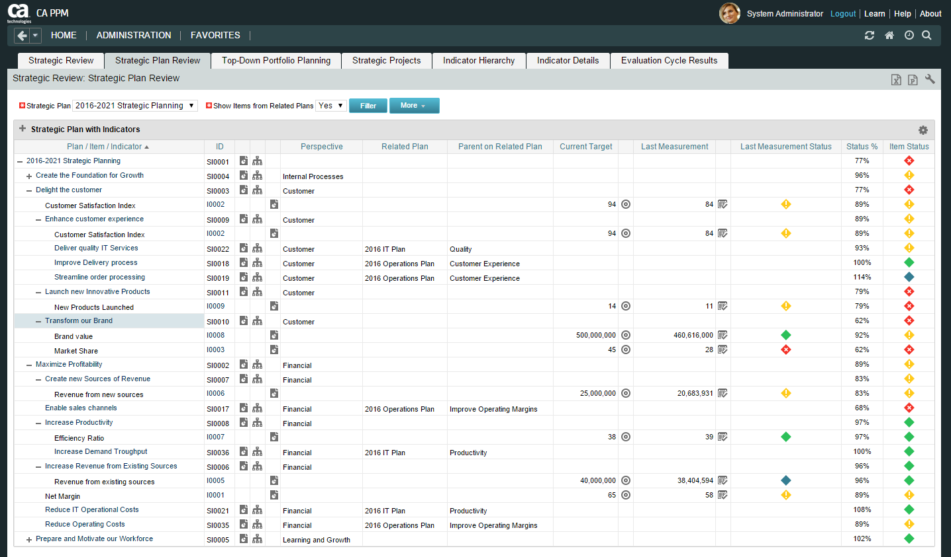
CA PPM for Strategic Planning and Execution
Configure you Strategic Plans using the multi-level Strategic Items feature (Themes, Goals, Objectives, Initiatives, … );
Create Related Plans, such as:
A Long-Term Corporate Plan;
Medium-Term Business Unit Plans;
Short-Term Department Plans;
Manage Strategy Risks and Risk Score.

Slide 8
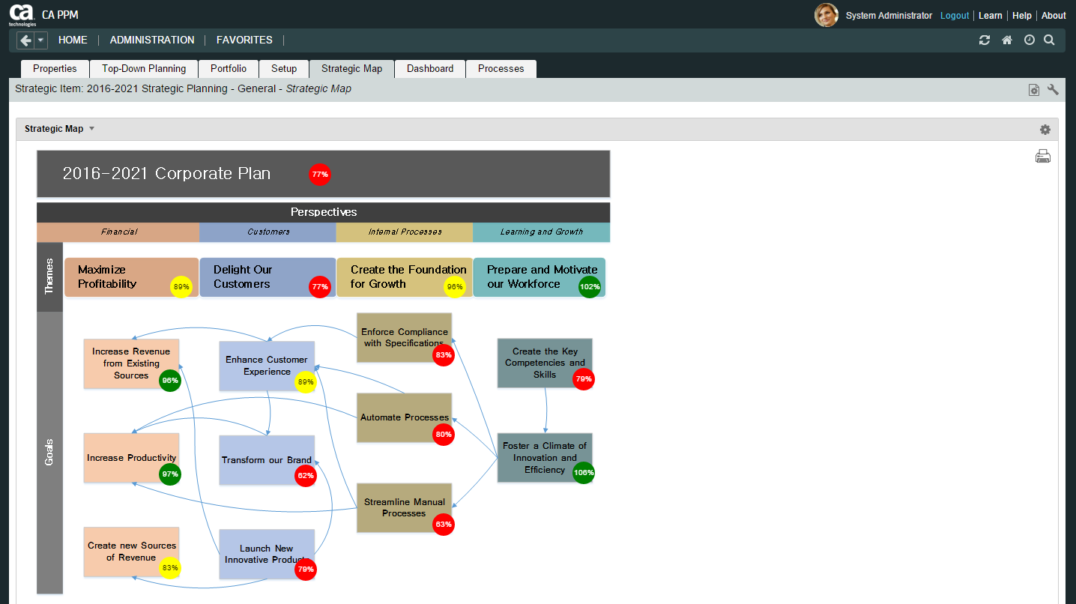
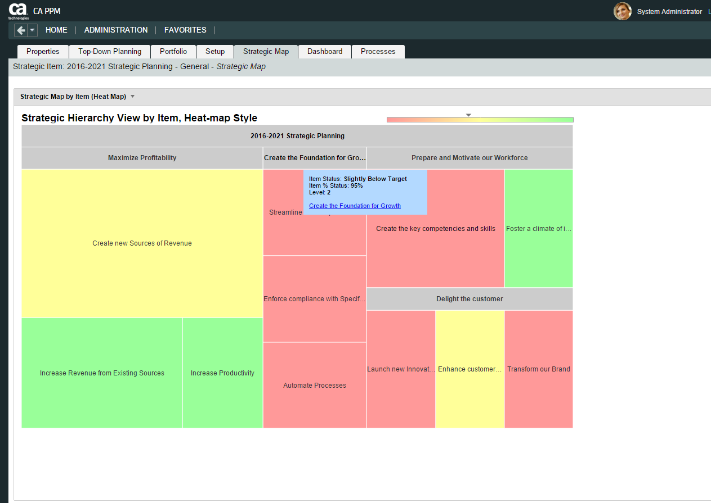
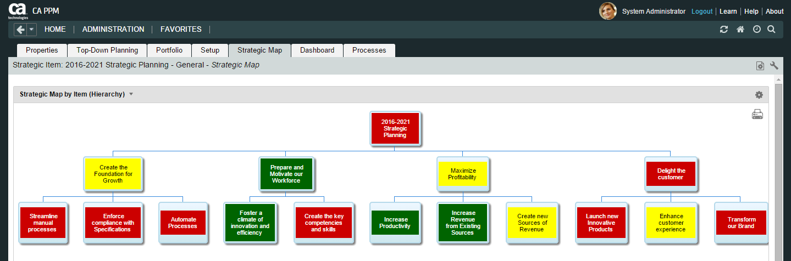
CA PPM for Strategic Planning and Execution
Multiple system-generated graphical views of your Strategic Plans;
Use a custom Strategic Map picture and easily add an information layer on top of it, showing the status of each Strategic Initiative or Goal.

Slide 9
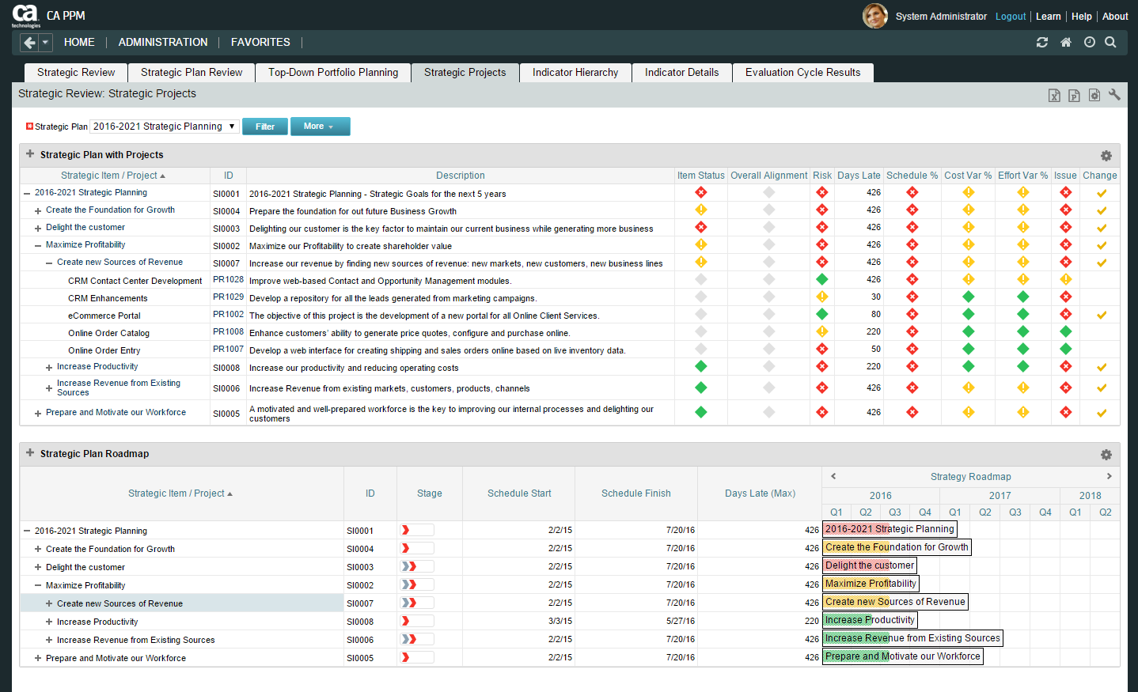
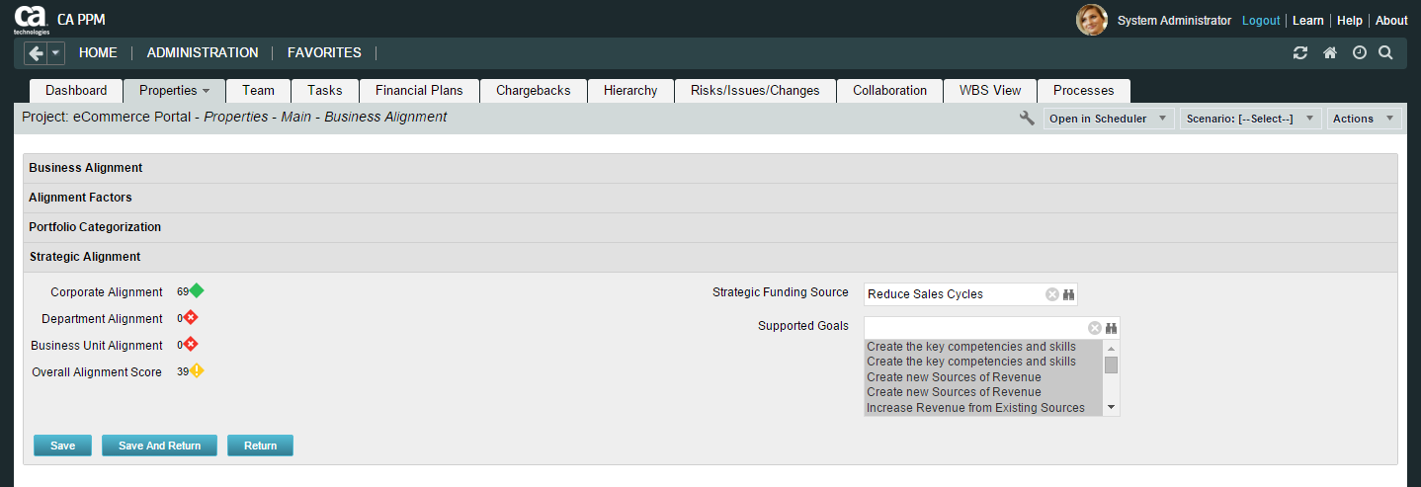
CA PPM for Strategic Planning and Execution
Link Your Strategic Projects to your Strategic Plans;
Monitor your Strategic Plan Health-Check, i.e. how the Strategic Projects may be Impacting your Plan;
Follow up on your Strategic Plan Delivery Roadmap to see when your Goals should be met.

Slide 10
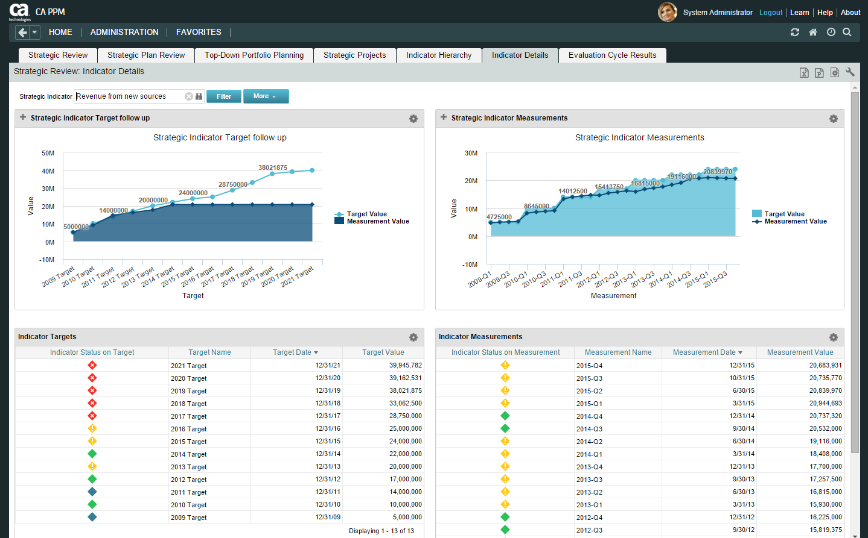
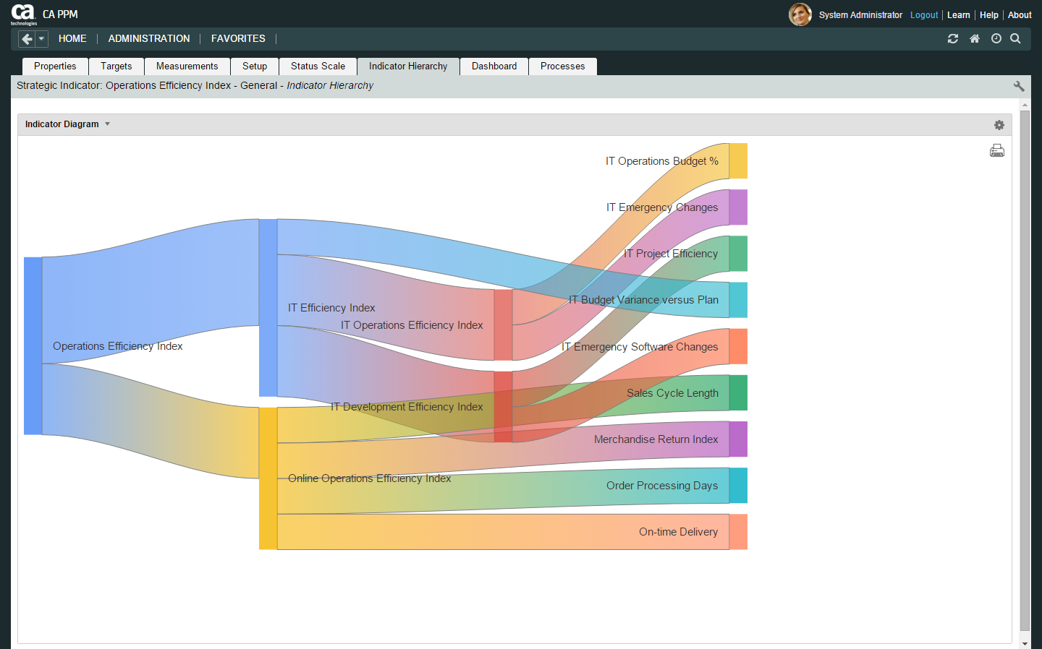
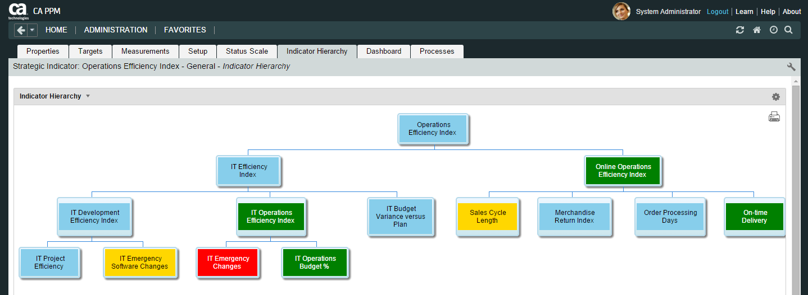
CA PPM for Strategic Planning and Execution
Create Strategic Indicators that will monitor the results of your strategies;
Set Targets and collect Measurements;
Calculate the resulting Status and update Strategic Plans automatically;
Indicate Cause-Consequence relationships using Indicator Hierarchies and review them graphically;
Track Indicator Issues and Issue Score.

Slide 11
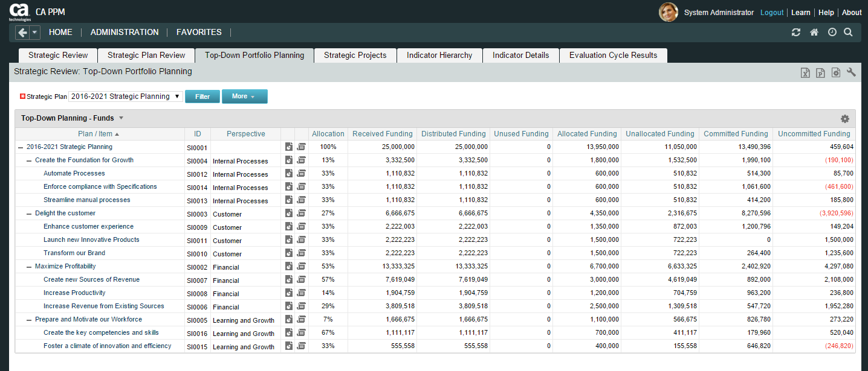
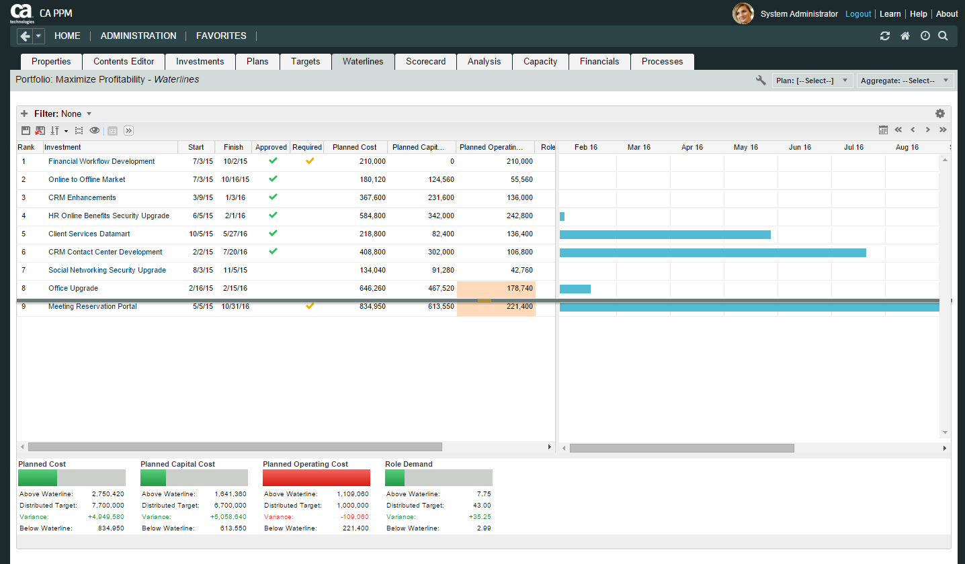
CA PPM for Strategic Planning and Execution
Balance your Investment Budget (Benefits, CAPEX & Headcount) between various Strategic Goals using the Top-Down Portfolio Planning feature;
Generate Investment Portfolios automatically based on your Balanced Goals and Related Projects

Slide 12
CA PPM for Strategic Planning and Execution Accelerator Implementation

Slide 13
CA PPM for Strategic Planning and Execution
The complete cycle in four big groups
2 Monitoring Plans
3 Investments Evaluation
1 Creating Plans
4 Top-Down Portfolios
Notes:
For easy-of-use and implementation we are presenting the new features in four big groups, and we present them in the order they would usually be implemented:
Strategic Maps with Items and related Strategic Projects
Strategic Review and Monitoring
Investment Evaluation for Selection and Prioritization
Top-Down Portfolio Planning to distribute Funds and Headcount

Slide 14
CA PPM for Strategic Planning and Execution
Group 1: Creating the Strategic Plans and the Indicators Hierarchy
Deliverable | Implementation Assumption (Pre-Requisites)
Multi-level Strategic Plans | A multi-level Strategic Plan consisting of, for instance, Themes, Goals, Objectives and Initiatives already exists, optionally, aligned to Strategic Perspectives (like in Balanced Score Card, for example).
Strategic Health-Check & Results Delivery Roadmap | A list of Strategic Projects supporting those Plans is already identified. The standard CA PPM Project Health-Check KPIs* are in use.
Graphical Strategic Map | A picture (JPG or PNG) of the Strategic Plan is available and/or the CA PPM server has an active Internet Connection (for Google Charts).
Optional: Indicator Hierarchy | The Global indicators used to measure the Strategic Plan results is already identified.
*(Days Late, Schedule %, Cost %, Effort %, Issues, Risk Score, Changes)

Slide 15
CA PPM for Strategic Planning and Execution
Group 2: Monitoring Plans with Strategic Review
Deliverable | Implementation Assumption (Pre-Requisites)
Indicator Hierarchy | The Global indicators used to measure the Strategic Plan results is already identified.
Multi-level Strategic Plans with current Status | Indicator Targets are defined and Indicator Measurements are being collected
Graphical Strategic Map with current Status | Indicator Targets are defined and Indicator Measurements are being collected
Results Trend Analysis | Indicator Targets are defined and Indicator Measurements are being collected

Slide 16
CA PPM for Strategic Planning and Execution
Group 3: Investment Evaluation for Selection
Deliverable | Implementation Assumption (Pre-Requisites)
Investments Evaluation (Alignment Assessment) | The Strategic Plan defines metrics to align the Strategic Goals to the Strategic Investments
 | The Strategic Investments have Business Cases assessing them against the Metrics of the Strategic Plans
 | A Portfolio Management Process is in place, using the Strategic Alignment as a decision-making variable.
 | There is a process to assess and re-assess investments periodically.

Slide 17
CA PPM for Strategic Planning and Execution
Group 4: Top-Down Portfolio Planning
Deliverable | Implementation Assumption (Pre-Requisites)
Top-Down Distribution of CAPEX Budget, Headcount and Benefits Expectation | A Budgeting process has defined the total amount of FTE, CAPEX and the expected Benefits from the Strategic Invesetments. These values will be distributed top-down to strategic goals.
Roll-up of Amounts allocated to Strategic Goals (Portfolios) and Commited to Investments | Each Strategic Investment knows its corresponding “Strategic Funding Source”, meaning, the Strategic Goal where its funds come from.
Automatic Creation of Portfolios for What-if Planning and Waterline analysis | A Portfolio Management Process is in place, using CAPEX and/or FTEs as constraints (optionally, OPEX and/or Expected Benefit can be used) to sort out the Investment list.

Slide 18
Alexandre Assis
Sr Director, Presales
Alexandre.Assis@ca.com
@cainc
slideshare.net/CAinc
linkedin.com/company/ca-technologies
ca.com

